Slide 1
Area Management
Orientation meeting
Fall 2023

Slide 2
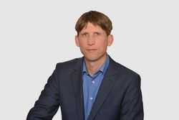
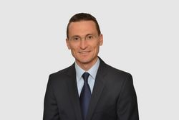
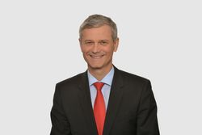
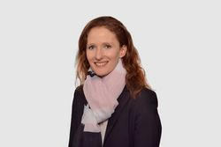
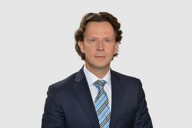
Area Management
The Area Management consists of five chairs which cover the dominant management functions and important institutional fields in management.
Chair of Human Resource Management and Leadership
Chair of Strategic and International Management
Chair of Strategic and International Management
Chair of Strategic and International Management
Prof. Dr.
Torsten Biemann
Prof. Dr.
Matthias Brauer
Chair of Public and Nonprofit Management
Chair of Organization
and Innovation
Chair of Entrepreneurship
and Family Business Research
Chair of Strategic and International Management
Chair of Strategic and International Management
Chair of Strategic and International Management
Prof. Dr.
Bernd Helmig
Prof. Dr.
Karin Hoisl
Prof. Dr.
Michael Woywode

Slide 3
Area Management
Chair of Human Resource Management and Leadership

Slide 4

Overview | Chair of Human Resource
Management & Leadership
Prof. Dr. Torsten Biemann
Professor of Human Resource Management and
Leadership at the University of Mannheim
Research
(Publications in top-tier journals, teaching case studies, conference appearances)
Teaching
(Bachelor, Master, PhD, Part-time/full-time/Executive MBA)
Practice
(Joint applied research studies, company trainings, guest lectures, consulting)
Orientation Meeting Area Management

Slide 5
Teaching | Chair of Human Resource Management & Leadership
PhD
MAN 805
Applied Methods in Management Research
¹ Lecturer: Frank Danesy
MAN 645
Leadership & Motivation
MAN 647
Strategic & International HRM
Master
Level
MAN 741
Seminar HRM
MAN 646
HR Analytics
MAN 648
Incentives & Performance
Master thesis
MAN 649
Human Resource Recruitment and Selection
¹
¹
MAN 644
[HR Training & Development]
MAN 352
Human Resource Management
Bachelor thesis
Bachelor Level
MAN 401 Organization & Human Resource Management
HWS
FSS
HWS & FSS
Business minors & incoming students
Orientation Meeting Area Management

Slide 6








Chair of Human Resource Management and Leadership
Teaching and Practice
Teaching Philosophy Statement
We teach practices that are informed by the best available scientific evidence in human resource management and leadership.
Theory-Practice Transfer: We collaborate with partners from practice in various ways, including company guest lectures, joint research projects, and student internships.
Teaching Methods: Our teaching methods include group work, lectures, case studies, and classroom experiments.
Career Opportunities: We offer an excellent preparation for work in HR departments, organization development, and consulting.
Selected Business Cooperations & Guest Lectures

Slide 7
Area Management
Chair of Strategic and International Management

Slide 8
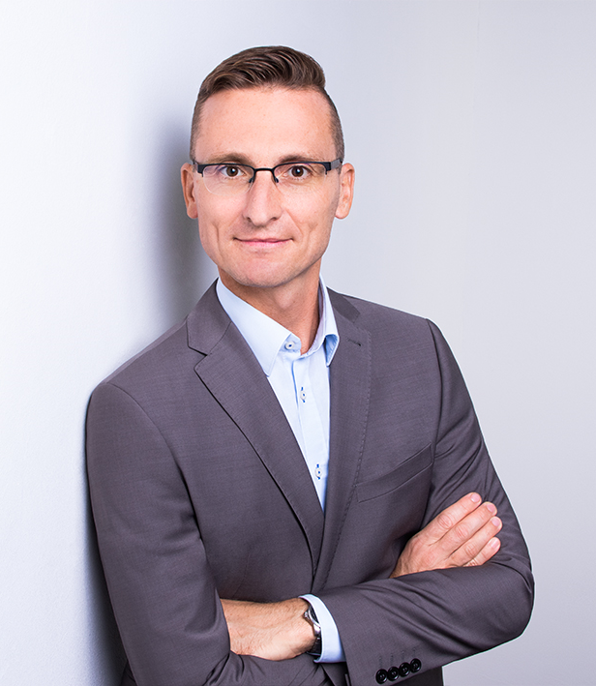
Overview | Chair of Strategic and
International Management
Our synergistic “business areas” and key output categories
Prof. Dr. oec. Matthias Brauer
Professor of Strategic and International
Management at the University of Mannheim
Research
(Publications in top-tier journals, teaching case studies, conference appearances)
Teaching
(Bachelor, Master, PhD, Part-time/full-time/Executive MBA, certificate programs)
Practice
(Joint applied research studies, company trainings, guest lectures, consulting)
Orientation Meeting Area Management

Slide 9













We aim to conduct rigorous and high-impact research …
Research | Chair of Strategic and
International Management
Chair for Strategic and International Management (SIM)
…in the key research areas of
Organizational transformation (i.e., M&A, divestitures)
Managing business groups for the long-term
Managing growth and building resilience
Effectiveness of management “tools“ and practices
Digital corporate entrepreneurship
…together with international research partners.
Fall 2023 / Spring 2024
Notes:
Key comment: Especially my work on M&A cuts across these different areas.
These topics cut across your six main research domains that you identified. I believe that these are not silos but there a substantial overlaps/interconnections.

Slide 10
Teaching | Chair of Strategic & International
Management
Graduate-
Level
MAN 804
Advances in Strategic Management
MAN 655
Corporate Strategy
Managing Business Groups
Master-
Level
MAN 656
Mergers & Acquisitions
MAN 750
Research seminar: Corporate Strategy & Governance
Master thesis
MAN 654
Corporate Restructuring
Bachelor- Level
MAN 301
Strategic Management
Bachelor thesis
HWS
FSS
HWS & FSS
Orientation Meeting Area Management

Slide 11
Area Management
Chair of Public and Nonprofit Management

Slide 12
Overview | Chair of Public and Non-Profit
Management
Prof. Dr. Bernd Helmig
Professor of Public and Non-Profit
Management at the University of Mannheim
Research
(Publications in top-tier journals, teaching case studies, conference appearances)
Teaching
(Bachelor, Master, PhD, Part-time/full-time/Executive MBA, certificate programs)
Practice
(Joint applied research studies, company trainings, guest lectures, consulting)
Orientation Meeting Area Management

Slide 13









Research Topics | Chair of Public and Nonprofit Management
Public and Nonprofit Sector
Research
Cooperations
Strategic Management:
Strategic positioning, Accountability, Success factor research, Digitalization
Market-oriented Management:
Brand Management, Fundraising, Behavioral Research, Social Marketing
HR Management:
Volunteering, Boards, Personnel development
Organization:
Hybrid Organizing, Algorithmic Decision-Making, Organizational Behavior, Networking
The Chair stands for an advance of knowledge in the fields of management through high-class state-of-the-art research.
Core competency of the chair is research in society-oriented service management in public and nonprofit management.

Slide 14
Teaching | Chair of Public and Nonprofit Management
PhD/ MMBR
MAN 802
Fundamentals of Nonprofit Management
Master
Level
MAN 679
Public & Nonprofit Management
MAN 675
Fundraising Management
MAN 680
Challenges of Public and Nonprofit Management – Case Study Seminar
MAN 6XX
Responsible Management (working title)
MAN 710
Research Seminar: Public & Nonprofit Management
Master thesis
MAN 6XX
Wissenschafts-Management (working title)
MAN 676
Challenges of Public Management
Bachelor Level
MAN 451
Nonprofit Management
Management
(Business Minors)
Bachelor thesis
HWS
FSS
HWS & FSS
Orientation Meeting Area Management

Slide 15
Area Management
Chair of Organization and Innovation

Slide 16
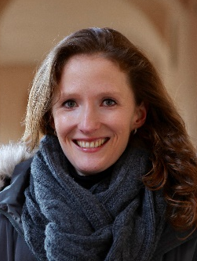
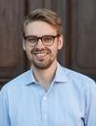
Overview | Chair of Organization and
Innovation
Prof. Dr. Karin Hoisl
Professor of Organization
and Innovation
Prof. Dr. Marc Lerchenmüller
Junior Professor of Technical
Innovation and Management
Service
Research
(Publications in top-tier journals, teaching case studies, conference appearances)
Teaching
(Bachelor, Master, PhD, Part-time/full-time/Executive MBA, certificate programs)
Practice
(Joint applied research studies, company trainings, guest lectures, consulting)
Orientation Meeting Area Management

Slide 17

Chair of Organization and Innovation –
RESEARCH
Research Approach: Quantitative empirical
Methods:
Data Sources:
- Large scale structured and unstructured secondary data
- Large scale surveys
- Experiments(lab, field, online)
Data Analysis:
- Regression analysis for cross-section, time series and panel data
- Machine-learning techniques
Theoretical Foundations:
Management, Economics, Social Sciences
Research Area:
IP & innovation, gender gaps in STEM, innovation in extreme environments, digital transformation,
the future of work, knowledge management, creativity, labor mobility, teams, sociology of science,
organization design, organization behavior

Slide 18
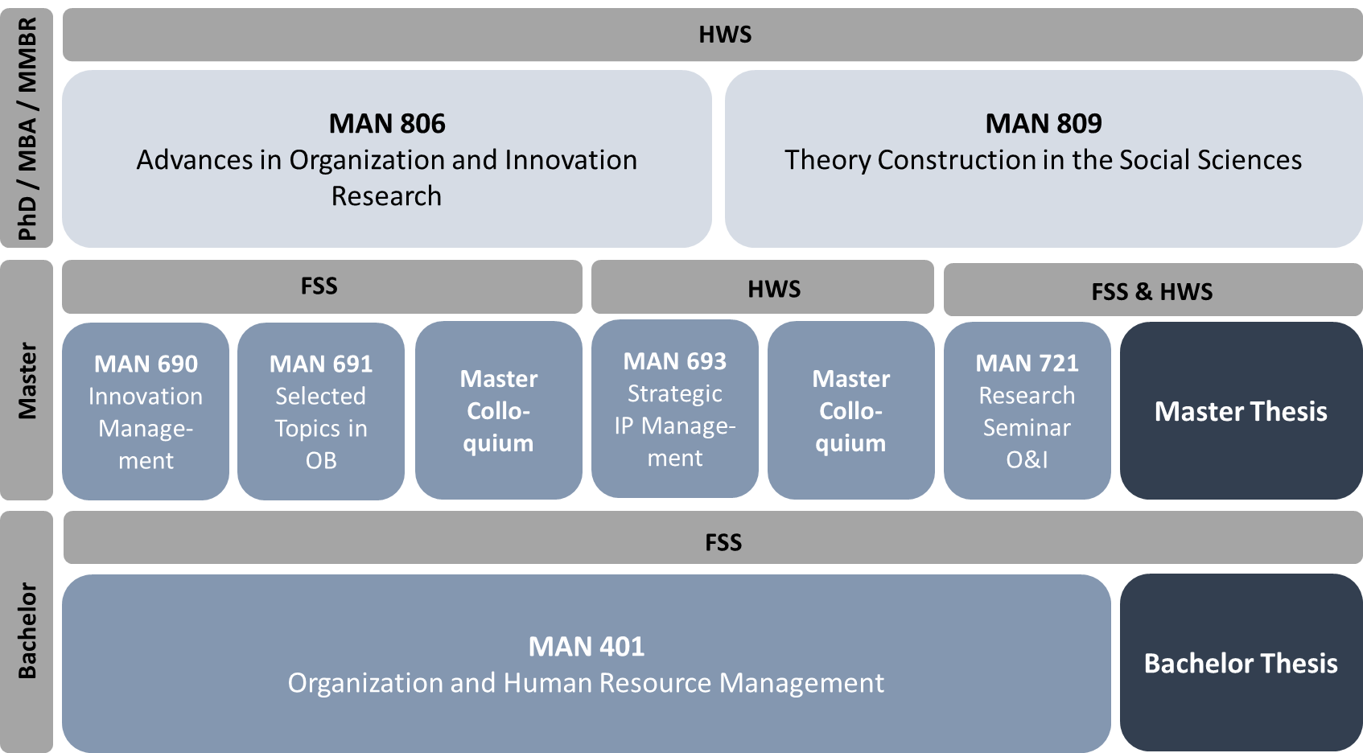
Chair of Organization and Innovation - TEACHING

Slide 19




































Research Collaborations
Industry Collaborations

Slide 20
Area Management
Chair of Entrepreneurship and Family Business Research

Slide 21
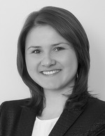
Overview | Chair for Entrepreneurship and Family Business Research
Prof. Dr. Michael Woywode
Professor for Entrepreneurship and Family Business
Research at the University of Mannheim
Junior Prof. Dr. Dominika Wruk
Sustainable Entrepreneurship
Research
(Publications in top-tier journals, teaching case studies, conference appearances)
Teaching
(Bachelor, Master, PhD, Part-time/full-time/Executive MBA, certificate programs)
Practice
(Joint applied research studies, company trainings, guest lectures, consulting)
Orientation Meeting Area Management

Slide 22









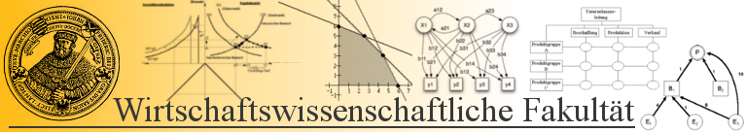

Chair for Entrepreneurship and Family Business Research
Research Mission
Key research interests include:
New Forms of entrepreneurship: Digital entrepreneurship, entrepreneurship in the sharing economy, sustainable entrepreneurship, female entrepreneurship, high tech entrepreneurship
Scaling the business, growth strategies, venture capital financing
Corporate Strategy & Governance in Family Firms
Hidden Champion Strategies for the Mittelstand
Diffusion, implementation, and performance impact of modern management concepts
Selected national & international research collaborations

Slide 23

Teaching | Chair for Entrepreneurship & Family Business Research
PhD
MAN 801
Advances in Entrepreneurship and Managemnt Research
MAN 630
Introduction to Entrepreneurship
MAN 632
Advanced Entrepreneurship
Master
Level
MAN 770
R. Seminar on Entrepreneurship
MAN 631
Creativity & Entrepreneurship
MAN 633
Growing the business
Master thesis
MAN 770
R. Seminar on Entrepreneurship
MAN 634
SDG entrepreneurhsip & crowdfunding
Bachelor Level
MAN 301
Introduction Strategic & International Management
MAN 450
Startup & Business Modelling
Bachelor thesis
Extracurricular
course offerings
& Startup Support
Elective BWL & incoming students
HWS
FSS
HWS & FSS
Orientation Meeting Area Management

Slide 24

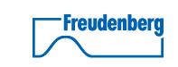
















Chair of Entrepreneurship and SME Research –
Preparing for a career as entrepreneur & in family business
Mannheim Center for
Entrepreneurship and Innovation
Business Cooperations
Mittelstand
Inspiration
Founder Talks
Startup Lounge
Startup Conferences
Curricular Courses
Master Theses
Business Development Center
Junior Accelerator
Entrepreneurship Bootcamp
Education
Start-ups
Startup Consulting
Online Community
Entrepreneurship Club
Inside the Venture
Mentoring
STATISTA
Support
AMORELIE
Payback
www.mcei.de

Slide 25
Area Management
Overview Teaching

Slide 26
Teaching Program MSc BWL (MMM)
Core
Compe-
tences
BIEMANN
BRAUER
HELMIG
HOISL
WOYWODE
MAN 645
LS & Mot.
MAN 647
Strat. Int.
HRM
MAN 656
M & A
MAN 654
Corp. Restr.
MAN 679
P & NP Mgt.
MAN 680
Chall. P. Mgt.
MAN 692
Org. Theory
MAN 690
Inno. Mgmt.
MAN 630
Intro. E’ship
MAN 632
Adv. E’ship
Master
Courses
MAN 646
HR Analytics
MAN 648
Inc. & Perf.
MAN 655
Corp. Strat.
MAN 675
Fundr. Mgt.
MAN 676
Partn. Mgt.
MAN 693
IP Mgmt.
MAN 691
OB
MAN 631
Creat. E’ship
MAN 633
Growth E.
MAN 649
HR Recr. &
Selection
MAN 64X
Training &
Developm.
MAN 694
Proj. C.
MAN 634
SDG Entr.
Research
Seminar
MAN 741
RS RSM (Fall) &
Leadership (Spring)
MAN 750
RS Corp. Strat. & Gov.
MAN 710
RS P & NP Mgt.
MAN 721
RS Orga. & Inno.
MAN 770
RS
CDSB /
MMBR
Modules
MAN 805
Appl. Meth.
Mgmt. R.
MAN 804
Adv. Strat.
Mgmt.
MAN 802
Fund. NP
Mgmt. Sci.
MAN 806
Adv. Organ.
Innov. R.
MAN 801
Adv. Entr.
Mgmt. R.
MAN 910 - Area Seminar
Thesis
MASTER THESIS
*suppl. course
FSS
HWS
FSS / HWS

